Slide 1
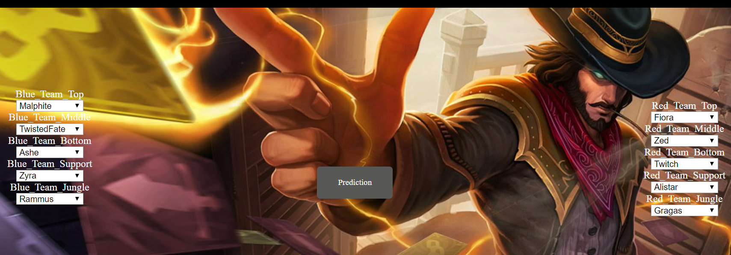
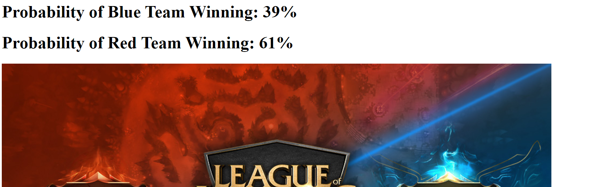
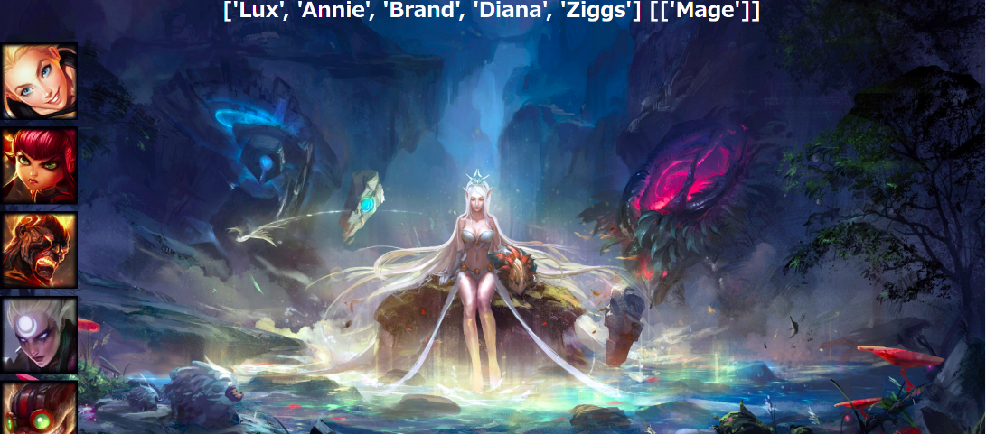
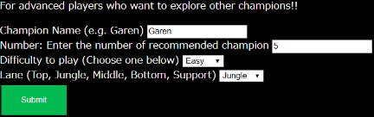
Champrediction
Match Prediction System:
Designed for ranked game players
Evaluating the chance of winning before the game, and players can decide whether they want to start playing that game, or dodge the match
Technologies Used :
Python, Pandas, RIOT API, HTML, Selenium, Beautifulsoup, HTML, Flask
Machine Learning Model:
Random Forest, Logistic Regression, ANN
Recommendation System:
Content-based filtering, K-nearest neighbour (KNN), Scipy hamming distance
Flask (Deployment)
Champion Recommendation System:
Designed for beginners and intermediate level players
Recommending starting and advanced champions to players based on champion features

Slide 2

Capstone Project
League of Legends Gaming Improvement
Project: Champrediction
Bruce Lam
Peter Li
Ryutaro
Shakti Gurung

Slide 3
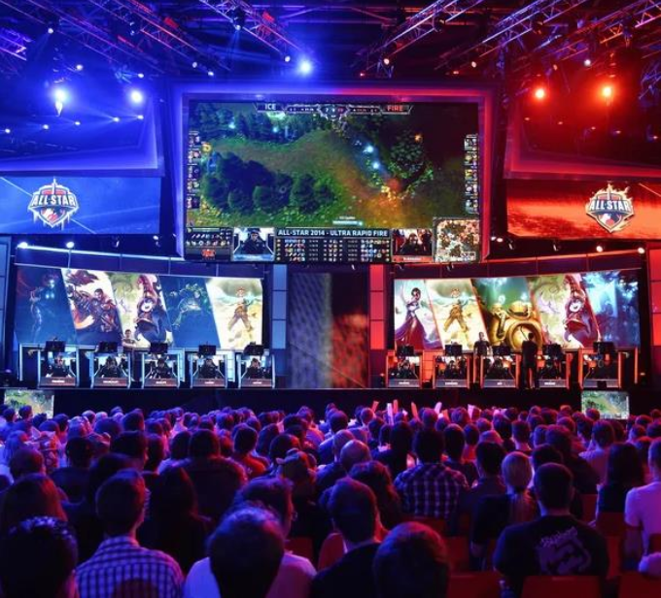
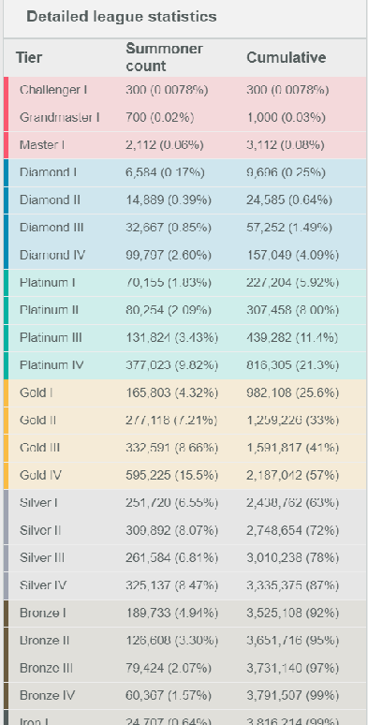
Why League of Legends?
An icon of the Esports Industry
Endless combination of champions, and strategies
Over 3.8 millions ranked game players in just KR server

Slide 4
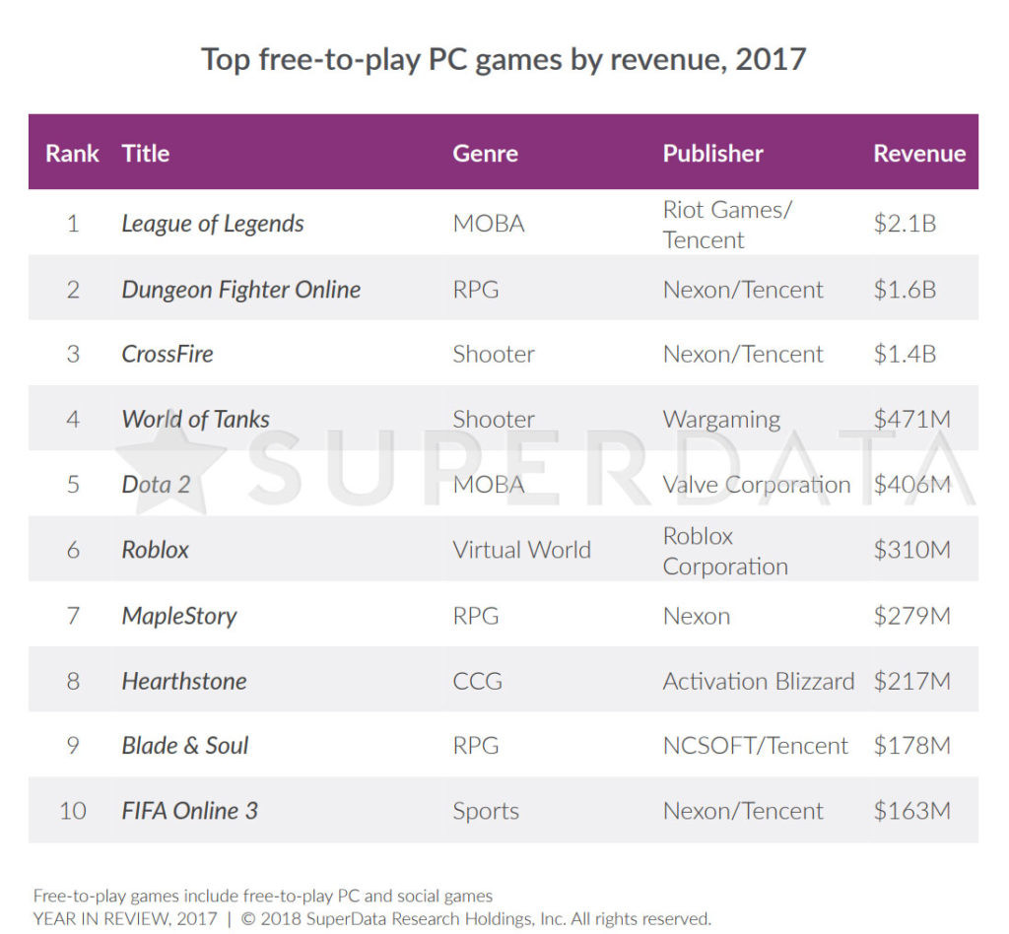
Why League of Legends?
Highest revenue free-to-play PC game in 2017
Most popular MOBA game

Slide 5
Aim
Improve gaming experience of League of Legends
Provides insights to gamers for League of Legends

Slide 6
How?
1. Match Prediction System (Machine Learning)
2. Recommendation System
(Based on champion features)

Slide 7
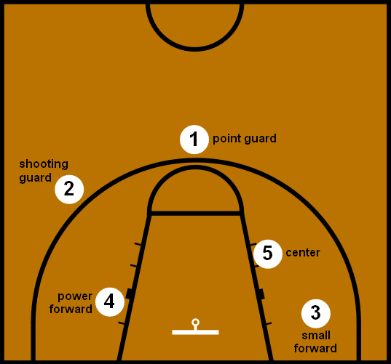
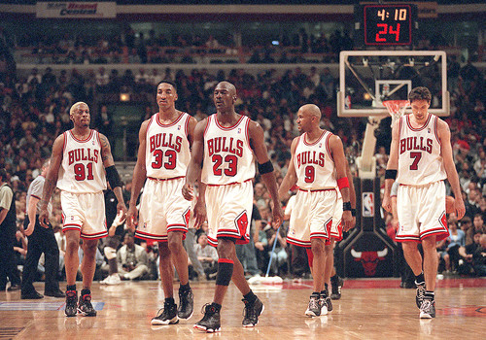
Brief Introduction
Two teams battle 5v5 in real time

Slide 8
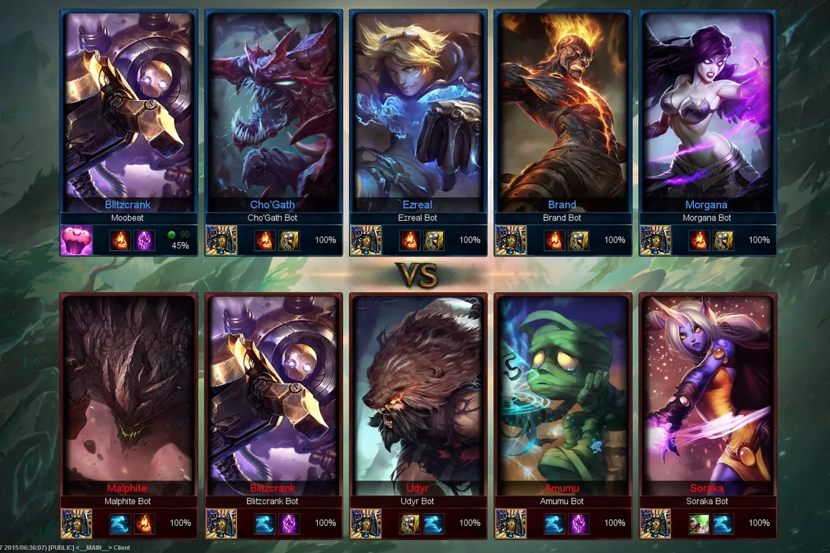
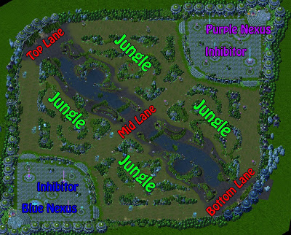
Champions are the player-controlled character in League of Legends. Each champion possesses unique abilities and attributes.
Map and Position
5 v 5

Slide 9
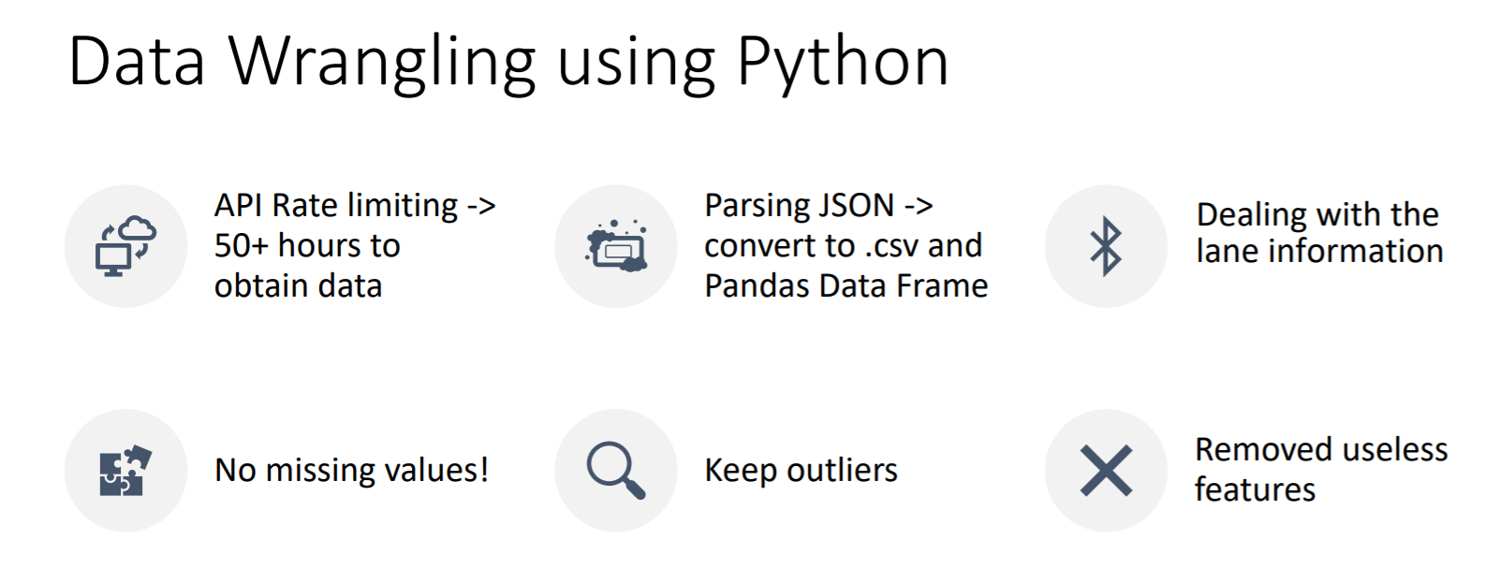
Data Wrangling From Riot API

Slide 10
Part 1 - Match Prediction Model

Slide 11
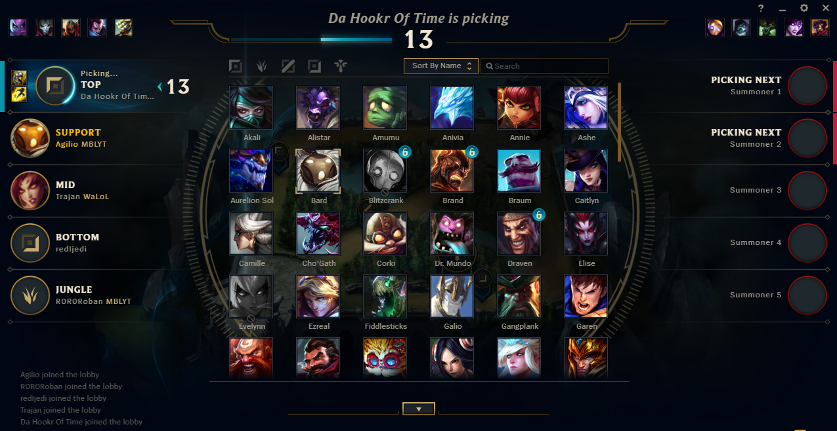
"Know the enemy and know yourself” - SUN Tsu
Ranked game players could evaluate their team composition during champion
selection, if they think the team composition is too bad, they can dodge the game.

Slide 12
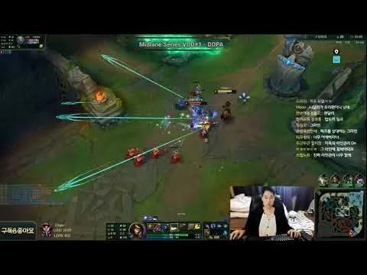
Provide Extra Information in Game Replay
Usually when players try to get insight from watching game replay, they tend to ignore the importance of team composition (Even for many players with advanced skill and game understanding), the ML model helps them to make better analytics

Slide 13

Input: The name of champions and position for Blue and Red team
Output : How likely Blue/Red team is going to win?

Slide 14
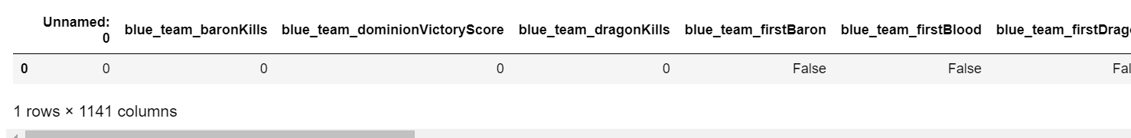
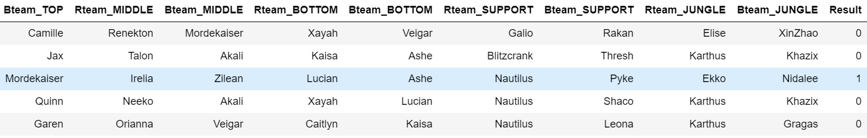
Preprocessing
After data cleaning, the dataframe looks like this:

Slide 15
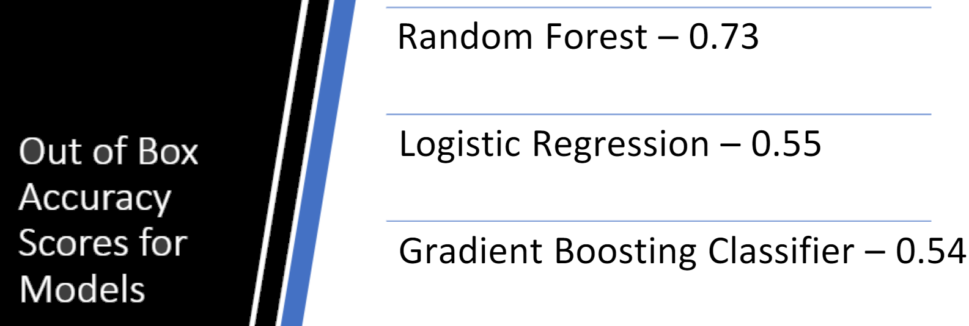
Choosing the Random Forest Classifier

Slide 16
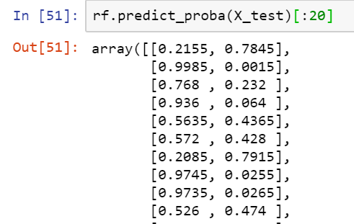
Probability of winning for Blue/Red team
A

Slide 17
Limitation
Only applicable in High levels of play too much variation in player skill and game knowledge in low level play
A separate model/data will be needed to predict match outcomes for each tier and region, as well as professional play. Model in this project would overfit for new data not from high ranked NA games.

Slide 18
Part 2 - Recommendation System

Slide 19
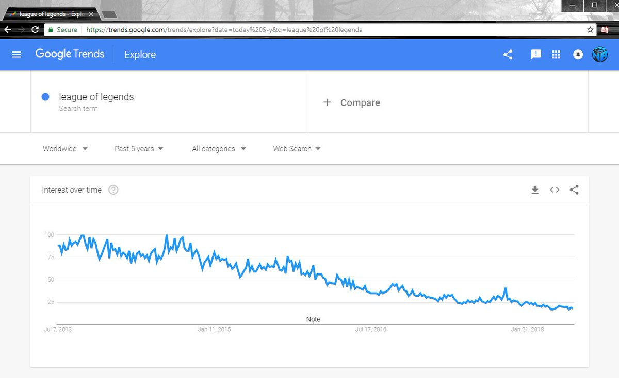
Why Recommendation System?
Loss of players’ interest
- Decline of interest of
new players and existing
players

Slide 20
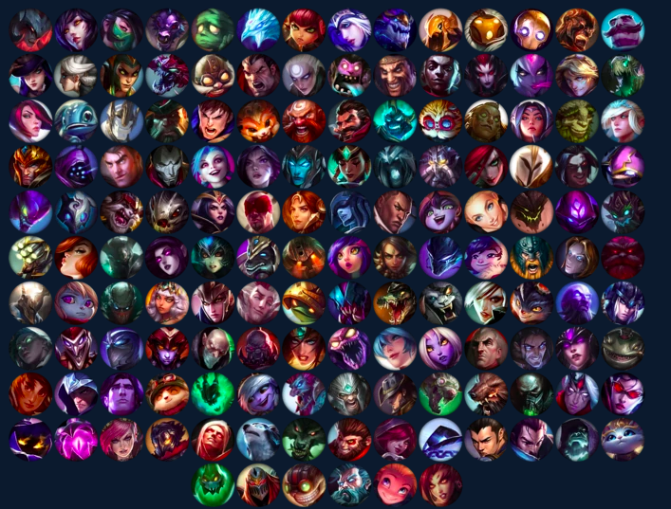
Why Recommendation System?
2. Difficult to get started with
- Need a lot of game
knowledge to understand
the champions
- Hard to find the most suitable
champion

Slide 21
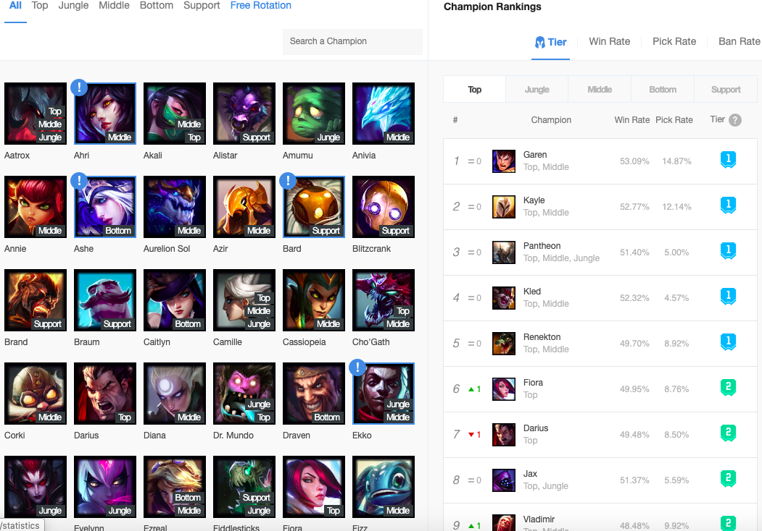
Why Recommendation System?
3. No good recommendation website currently
Most popular web: OP.GG
- no good recommendation
- not comprehensive
- only include tier, win rate
and pick rate

Slide 22
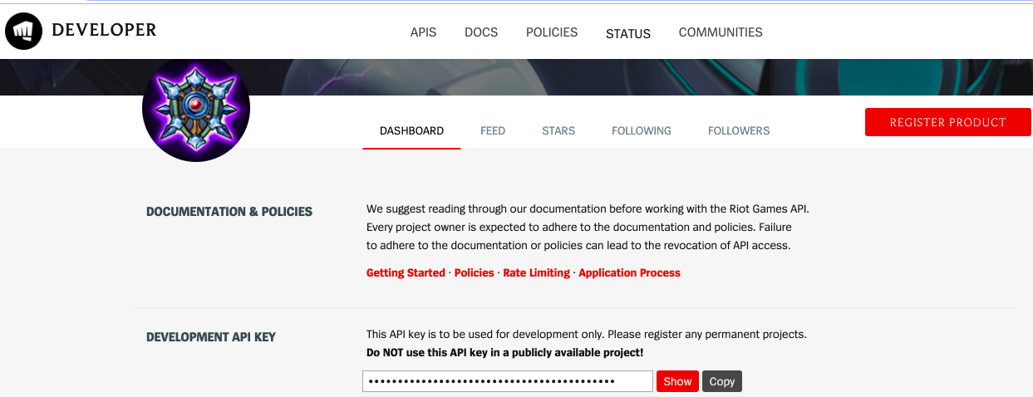
Recommendation System (How to gather champion data?)
1. get champion data from Riot API

Slide 23
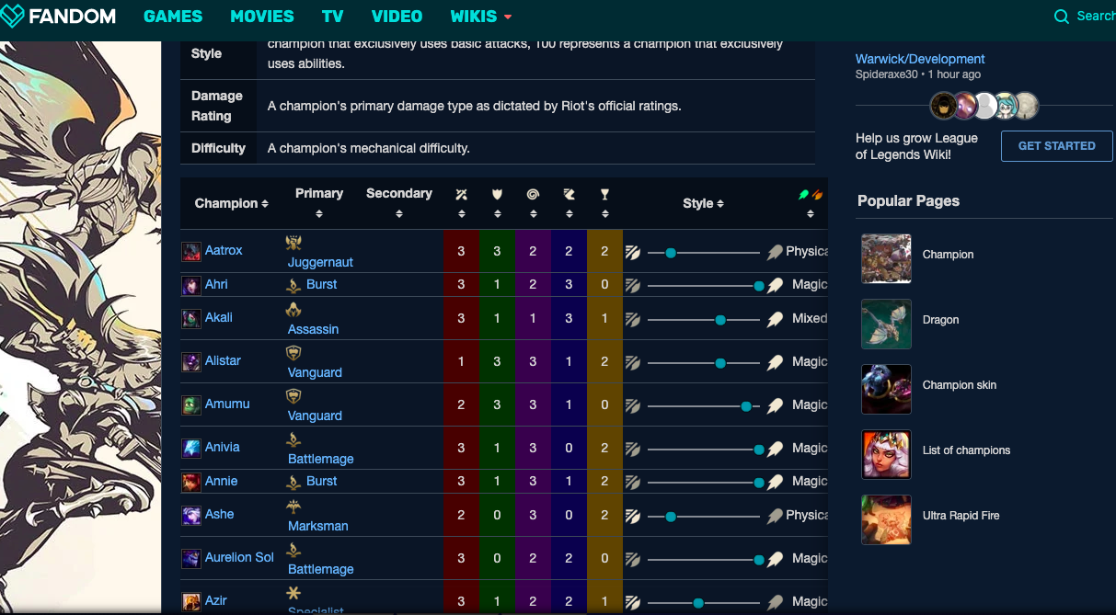
Recommendation System (How to gather champion data?)
2. get champion feature from fandom.com using Selenium

Slide 24
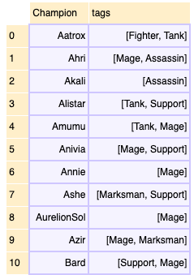
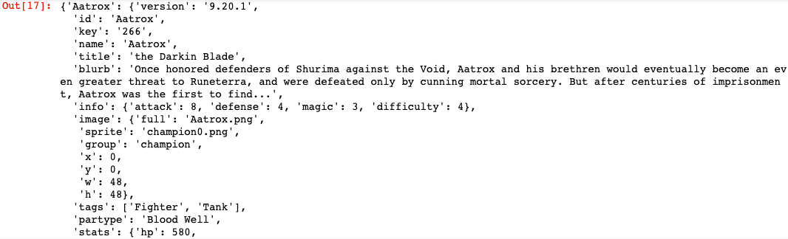
Data Cleaning
some data processing
clean the data and get the champion features dataframe

Slide 25
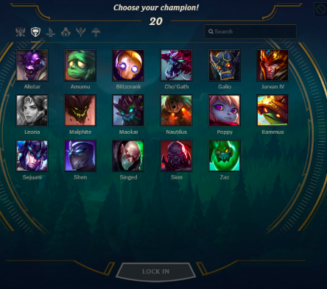

Recommmendation (first champion)
1. provide suggestion of the very first champion to new players
First Way: Choose by trying yourself!!
Top Comment from Reddit:
Play whoever you find fun/ looks cool to you.
It doesn't really matter for beginners since better mechanics win at your level of play.

Slide 26
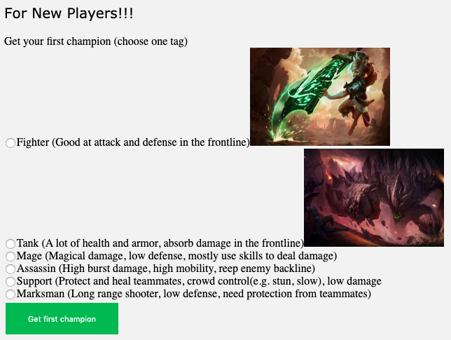
Recommmendation (first champion)
Or … If you are very new to the game …
Second Way: Use the recommendation system
Input a tag (e.g. Mage)
Return a ‘Easy’ champion

Slide 27
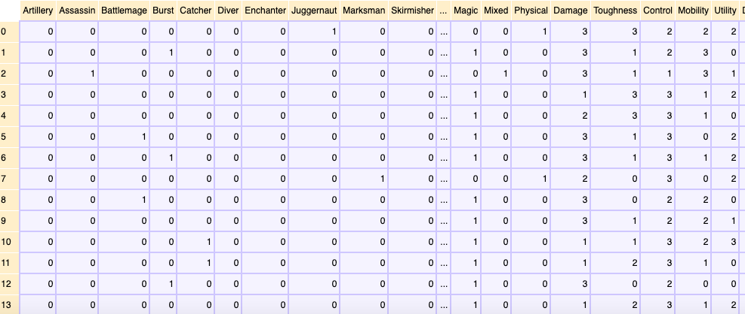
Recommendation (Content-based filtering)
2. Recommendation based on a similar champion you provided
get the second/ similar champions that the player most probably like
using the k nearest neighbour
finding hamming distance

Slide 28
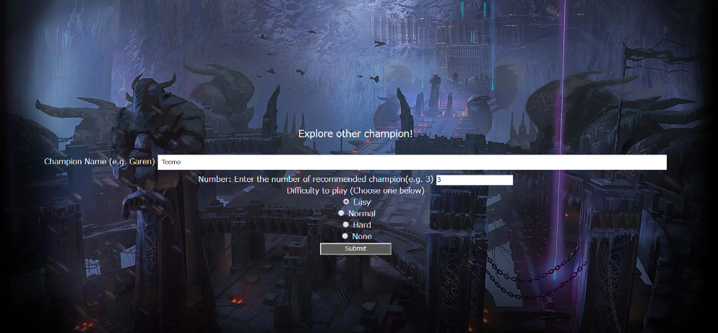
Deployment of Recommendation
-Input: 1. A champion that the user found interesting/ play well
2. Number of champions
3. Difficulty
4. Lane
-Return: similar champions that have similar features

Slide 29
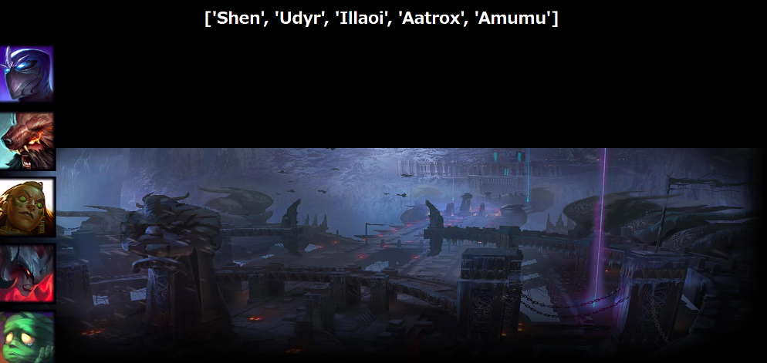
Deployment of Recommendation
-The order matters: The first one is the most similar
-Tank usually are easy to play
-There will be more descriptions of the champions

Slide 30


Limitation of Recommendation System
Some of the data are very subjective, e.g. Is that champion an assassin ?
Is the champion easy to play ?
Better way of recommendation ? Such as collaborative filtering.

Slide 31
Part 3 - Getting insight from game analytics
Help players make better decision in the game

Slide 32

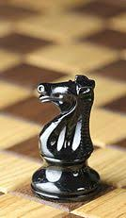
Comparison of Map Objective
There are many kinds of objective in the map, to improve your winning rate:
Just like chess game, in the game we do a lot of strategic “trading”*, in order to make better decision, we need to know which type of objective is better than another one.
* (Trading means if I take objective A, the other team get objective B) :
FOR
?

Slide 33

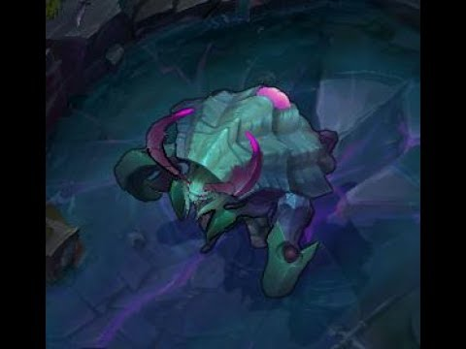
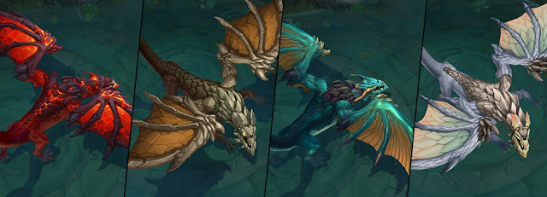
How to answer these questions?
Tower
RiftHerald
OR
?
Dragon
Tower
OR
?

Slide 34
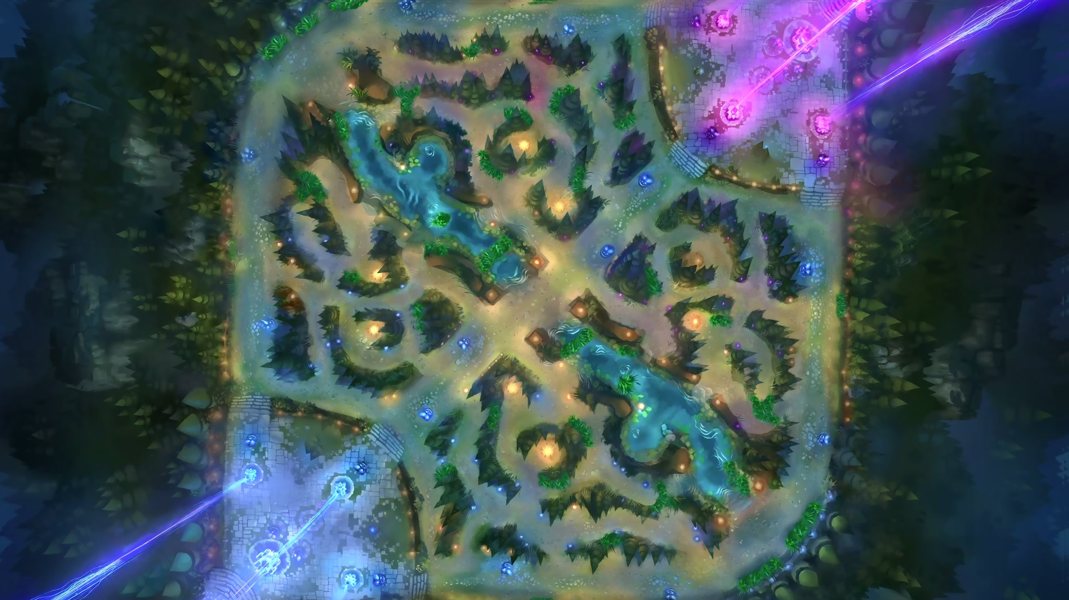
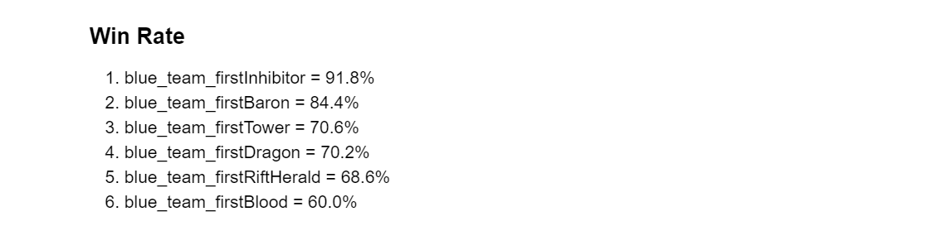
By Gaming Analytics
By comparing the win rate of getting first of different kind of objectives, we can answer those questions in some extent:
Inhibitor > Baron
Tower > Dragon
Dragon > Herald
Herald > One kill
2,5
1
3
4

Slide 35
One page to show the overall project
Input
Process
Output
① Recommendation
1.Champion Tag 2.Champion Name
(Favorite Champion)
① Recommendation
1.Content-Based Filtering
2.Scipy Hamming Distance
① Recommendation
1.First Champion
2.Other Champions
(Users Probably Like)
Champion Data from Riot API
② Prediction
Champion Names
(Blue/Red Team)
② Prediction
1.Logestic Regression 2.Gradient Boosting
3.Random Forest
② Prediction
Win Rate Probability
(Blue/Red team)
③ Data Analyzing
1.Riot API
2.Youtube API
③ Data Analyzing
Pandas
③ Data Analyzing
Better Decisions Info

